Slide 1
Build apps with the Microsoft Graph REST API
Manually interacting with the Microsoft Graph REST API

Slide 2

Manually interacting with the Microsoft Graph REST API
Authenticating with Azure AD
Obtaining an OAuth2 access token
Calling the Microsoft Graph REST API

Slide 3
Obtaining an OAuth2 access token from Azure AD

Slide 4
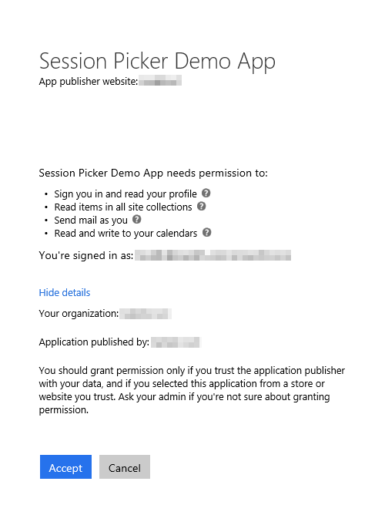
Azure AD OAuth in Microsoft 365
Single authentication flow
Across all Office 365 services
“Native” apps and web sites
Admin and end-user consent
Secure protocol
OAuth 2.0 (no capturing user credentials)
Fine-grained access scopes
Supports MFA and federated user sign-in
Long-term access through refresh tokens
Unique considerations of “Native” Azure Apps
Inherently multi-tenant
No client/app secret (think about distribution)
Leverage a web authentication window/broker
Notes:
All Office 365 cloud services, including SharePoint Online, and Microsoft Graph, leverage Azure AD for authentication and authorization
This means there is a single authentication flow to use Office 365 applications as well as those created to leverage the Microsoft Graph

Slide 5
Azure AD: Authentication & Authorization
Prior to calling the Microsoft Graph REST API, you must obtain an access token
Select an OAuth 2.0 flow for your scenario
OAuth 2.0 authorization code grant flow most common for interactive apps
https://docs.microsoft.com/en-us/azure/active-directory/develop/active-directory-v2-protocols-oauth-code

Slide 6
Manually obtaining an authorization code from the Azure AD OAuth v2 authorization endpoint

Slide 7
Step 1: Obtaining the Authorization Code
Use the browser to redirect user to login & receive an authorization code
User provides authorization code to the application
Application provides the authorization code to Azure AD for an access token
Request the authorization code from the Azure AD v2 authorization endpoint
https://login.microsoftonline.com/common/oauth2/v2.0/authorize? client_id={{REPLACE_APPLICATION_ID}} &response_type=code &redirect_uri={{REPLACE_REDIRECT_URL_UPON_SUCCESSFUL_AUTH}} &response_mode=query &scope={{REPLACE_SPACE_DELIMITED_SCOPE_LIST}} &state={{REPLACE_YOUR_DEFINED_VALUE}}
Notes:
To request an authorization code, you must initiate an interactive login using a URL with specific parameters from the Azure AD OAuth2 v2 authorization endpoint.
This will start the interactive login process with Azure AD, prompt the user to grant the application consent (if they haven’t already for the requested scopes) and redirect the user to the redirect URI with the requested authorization code.
Include the following values in query string of the URL:
client_id = the Azure AD application ID
scope = space delimited list of scopes (aka: permissions) requested
response_type = tells the endpoint the type of grant you are requesting… in this case you are using the authorization code flow
response_mode = Specifies the method that should be used to send the resulting token back to your app. Can be query or form_post
redirect_uri = the same URI used when requesting the authorization code
state = value included in the request that will also be returned in the token response. It can be a string of any content that you wish. A randomly generated unique value is typically used for preventing cross-site request forgery attacks. The value can also encode information about the user's state in the app before the authentication request occurred, such as the page or view they were on.
https://docs.microsoft.com/azure/active-directory/develop/active-directory-v2-protocols-oauth-code

Slide 8
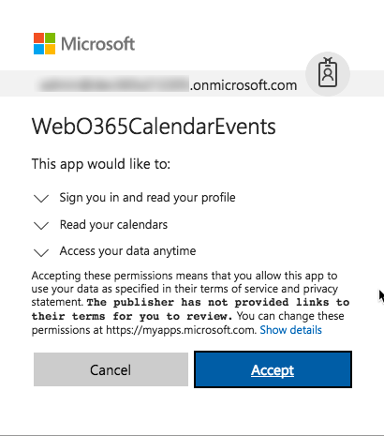
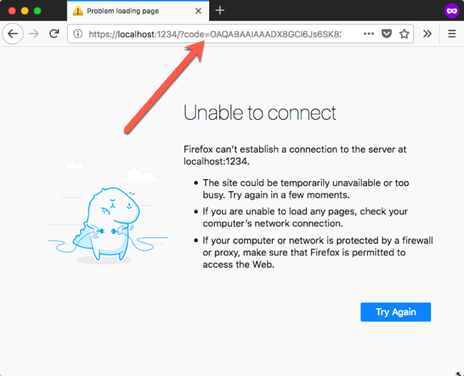
Step 1: Obtaining the Authorization Code
Notes:
To request an authorization code, you use the previously constructed URL in a browser.
This triggers the interactive login & consent dialog (if this is the first time you’re logging in to use this Azure AD application)
Upon a successful login, Azure AD will redirect you to the specified URL with the following values on the query string:
Code = the authorization code
State = if provided in the initial request, this will contain the same value that you can use to check for spoofing

Slide 9
Manually obtaining an access token from the Azure AD OAuth v2 token endpoint

Slide 10
Step 2: Exchanging Authorization Code for Access Token
Use the provided authorization code to request
Application uses the access token to call the Microsoft Graph REST API
Request the authorization code from the Azure AD v2 token endpoint
POST https://login.microsoftonline.com/comon/oauth2/v2.0/token
Content-Type: application/x-www-form-urlencoded
client_id={{REPLACE_APPLICATION_ID}} &scope={{REPLACE_SPACE_DELIMITED_SCOPE_LIST}}
&code={{REPLACE_AUTHORIZATION_CODE}}
&redirect_uri={{REPLACE_REDIRECT_URL_UPON_SUCCESSFUL_AUTH}}
&grant_type=authorization_code
&client_secret ={{REPLACE_APPLICATION_ID}}
Notes:
Requesting an access token can be made programmatically (not interactively)
Issue an HTTP POST to the Azure AD OAuth2 v2 token endpoint
Include the following values in the body of the request, form encoded:
client_id = the Azure AD application ID
client_secret = the Azure AD application password
scope = space delimited list of scopes (aka: permissions) requested
code = the authorization code
grant_type = tells the token endpoint the type of grant you are using… in this case you are using the authorization code flow. Other types include refresh_token
redirect_uri = the same URI used when requesting the authorization code
https://docs.microsoft.com/azure/active-directory/develop/active-directory-v2-protocols-oauth-code

Slide 11
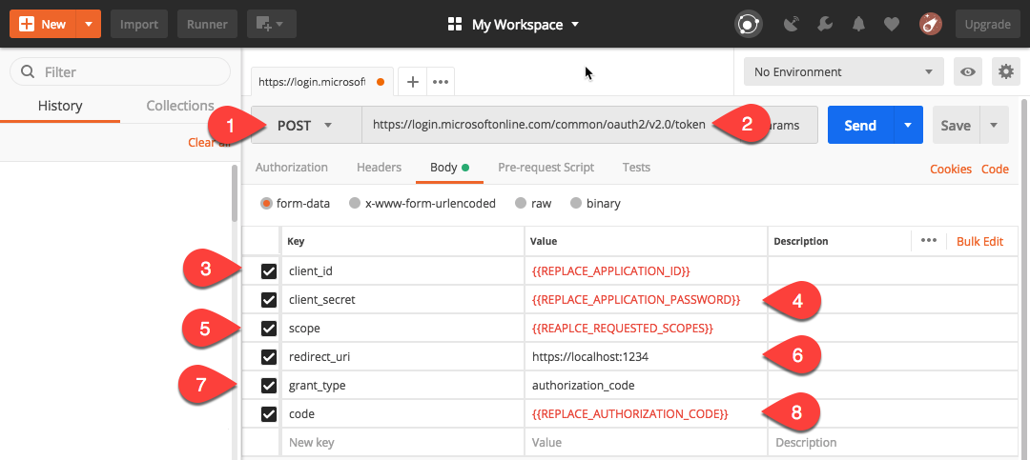
Step 2: Exchanging Authorization Code for Access Token
Notes:
Once you have an authorization code, you need to exchange it for an access token.
The authorization code expires in just a few moments, so it’s best to request an access token immediately after obtaining an authorization code
The screenshot is from the utility Postman which makes it easy to create HTTP requests
https://www.getpostman.com/pricing

Slide 12
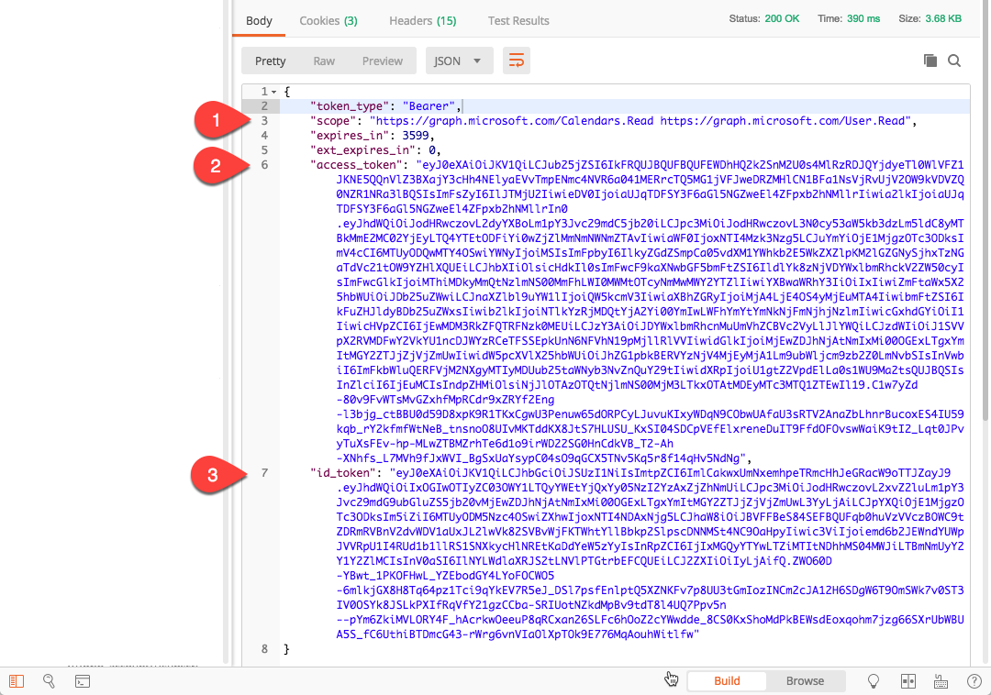
Step 2: Exchanging Authorization Code for Access Token
Notes:
This shows the results from the previous slide’s request.
Notice:
The token type is a Bearer token
The scopes are what permissions the access token is granted for
The access token is a JWT token… you can decode this to see the contents using a JWT decoder such as https://jwt.io
The id token is an JWT token returned from issuing the scope openid in the token endpoint request
The screenshot is from the utility Postman which makes it easy to create HTTP requests
https://www.getpostman.com/pricing

Slide 13
Manually requesting the Microsoft Graph REST API

Slide 14
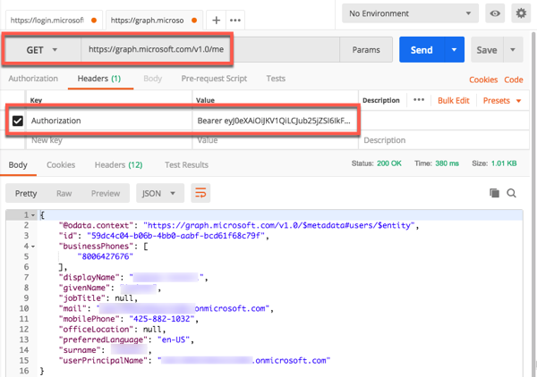
Directly Calling the Microsoft Graph REST API
Use the previously acquired access token to access the Microsoft Graph REST API
Include the access token in an HTTP header Authorization with the prefix Bearer as the value
Notes:
To call the Microsoft Graph REST API, you must include the OAuth access token in the request headers.
Add a header Authorization
The value of the header is Bearer<space><authorization code>
The screenshot is from the utility Postman which makes it easy to create HTTP requests
https://www.getpostman.com/pricing

Slide 15
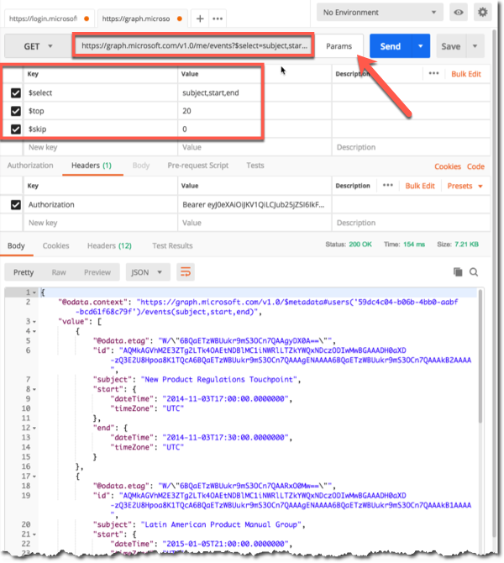
Use OData Query Parameters to Manipulate the Results
Use common OData syntax to control the results returned
https://developer.microsoft.com/en-us/graph/docs /concepts/query_parameters
$select
$top
$skip
$filter
$count
$orderby
$expand
Notes:
https://developer.microsoft.com/graph/docs/concepts/query_parameters
To control the query and results returned by the Microsoft Graph REST API, use OData query parameters
Add these to the endpoint querystring as different parameters:
$select = Filter properties
$top = Sets the page size of results
$skip = Indexes into a result set and used to implement paging in combination with $top
$filter = Filters results
$count = Retrieves the total count of matching resources
$orderby = Orders the results
$expand = Retrieves related resources
The screenshot is from the utility Postman which makes it easy to create HTTP requests
https://www.getpostman.com/pricing

Slide 16
Demo

Slide 17
Thank you.

